Slide 1
F# Succinct, Expressive, Functional
The F# Team
Microsoft Developer Division
Microsoft Research

Slide 2
Topics
What is F# about?
Some Simple F# Programming
F# Technical Overview

Slide 3
What is F# about?
Or: Why is Microsoft investing in functional programming anyway?

Slide 4
Simplicity

Slide 5
Economics

Slide 6
Fun! Fun! And More Fun!

Slide 7
Simplicity

Slide 8
Code!
//F#
open System
let a = 2
Console.WriteLine a
//C#
using System;
namespace ConsoleApplication1
{
class Program
{
static int a()
{
return 2;
}
static void Main(string[] args)
{
Console.WriteLine(a);
}
}
}
More Noise
Than Signal!

Slide 9
Pleasure
Pain
type Command = Command of (Rover -> unit)
let BreakCommand =
Command(fun rover -> rover.Accelerate(-1.0))
let TurnLeftCommand =
Command(fun rover -> rover.Rotate(-5.0<degs>))
abstract class Command
{
public virtual void Execute();
}
abstract class MarsRoverCommand : Command
{
protected MarsRover Rover { get; private set; }
public MarsRoverCommand(MarsRover rover)
{
this.Rover = rover;
}
}
class BreakCommand : MarsRoverCommand
{
public BreakCommand(MarsRover rover)
: base(rover)
{
}
public override void Execute()
{
Rover.Rotate(-5.0);
}
}
class TurnLeftCommand : MarsRoverCommand
{
public TurnLeftCommand(MarsRover rover)
: base(rover)
{
}
public override void Execute()
{
Rover.Rotate(-5.0);
}
}

Slide 10
Pleasure
Pain
type Expr =
| True
| And of Expr * Expr
| Nand of Expr * Expr
| Or of Expr * Expr
| Xor of Expr * Expr
| Not of Expr
public abstract class Expr { }
public abstract class UnaryOp :Expr
{
public Expr First { get; private set; }
public UnaryOp(Expr first)
{
this.First = first;
}
}
public abstract class BinExpr : Expr
{
public Expr First { get; private set; }
public Expr Second { get; private set; }
public BinExpr(Expr first, Expr second)
{
this.First = first;
this.Second = second;
}
}
public class TrueExpr : Expr { }
public class And : BinExpr
{
public And(Expr first, Expr second) : base(first, second) { }
}
public class Nand : BinExpr
{
public Nand(Expr first, Expr second) : base(first, second) { }
}
public class Or : BinExpr
{
public Or(Expr first, Expr second) : base(first, second) { }
}
public class Xor : BinExpr
{
public Xor(Expr first, Expr second) : base(first, second) { }
}
public class Not : UnaryOp
{
public Not(Expr first) : base(first) { }
}
http://stepheneasey.wordpress.com/tag/c/

Slide 11
Pleasure
Pain
let rotate (x,y,z) = (z,x,y)
let reduce f (x,y,z) =
f x + f y + f z
Tuple<V,T,U> Rotate(Tuple<T,U,V> t)
{
return new Tuple<V,T,U>(t.Item3,t.Item1,t.Item2);
}
int Reduce(Func<T,int> f,Tuple<T,T,T> t)
{
return f(t.Item1) + f(t.Item2) + f (t.Item3);
}

Slide 12
Economics

Slide 13
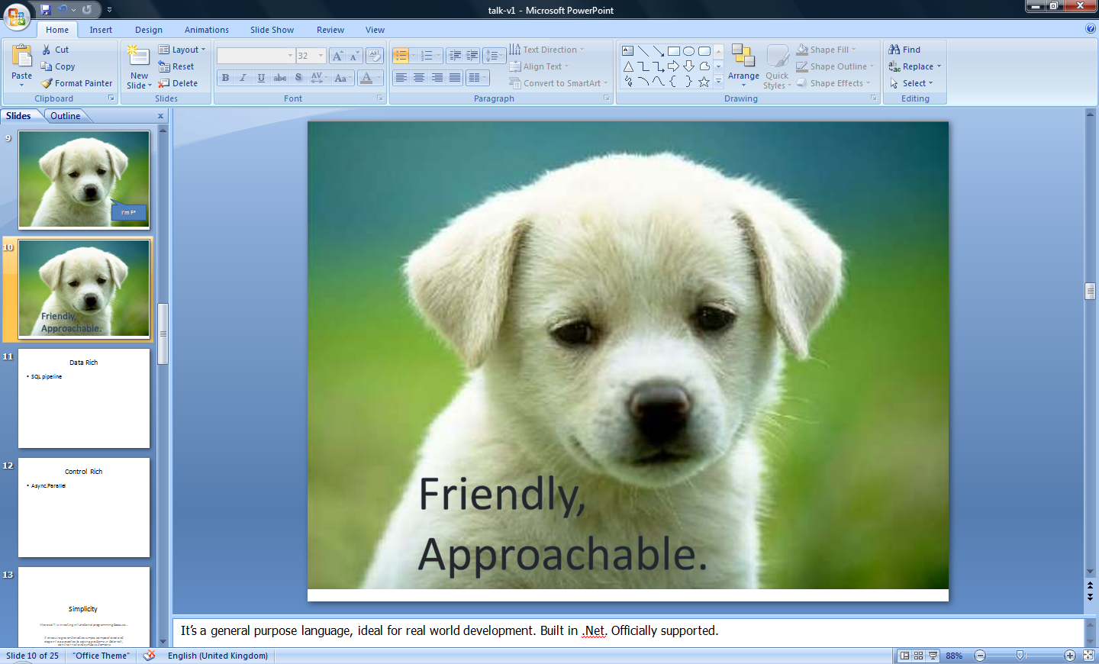


Slide 14
You
Can
Interoperate
With
Everything

Slide 15
Everything
Can
Interoperate
With
You

Slide 16
Fun! Fun! Fun!

Slide 17
People
Love
Programming
In
F#

Slide 18
F#: Influences
OCaml
C#/.NET
F#
Similar core
language
Similar object
model

Slide 19
F#: Combining Paradigms
I've been coding in F# lately, for a production task. F# allows you to move smoothly in your programming style... I start with pure functional code, shift slightly towards an object-oriented style, and in production code, I sometimes have to do some imperative programming.
I can start with a pure idea, and still finish my project with realistic code. You're never disappointed in any phase of the project!
Julien Laugel, Chief Software Architect, www.eurostocks.com

Slide 20
F#: The Combination Counts
Statically Typed
Succinct
F#
Libraries
Explorative
Interoperable
Efficient
Scalable

Slide 21
Demo: Let’s WebCrawl…

Slide 22
Weakly Typed? Slow?
//F#
#light
open System
let a = 2
Console.WriteLine(a)
//C#
using System;
namespace ConsoleApplication1
{
class Program
{
static int a()
{
return 2;
}
static void Main(string[] args)
{
Console.WriteLine(a);
}
}
}
Looks Weakly typed?
Maybe Dynamic?
Notes:
But why does F# omit any type information? Is it not type safe? Is it coercive maybe? Or weakly typed? Maybe this is one of those dynamic languages I read about at 37 signals?

Slide 23
Typed
Untyped
Efficient
Interpreted
Reflection Invoke
F#
Yet rich, dynamic
Yet succinct
Notes:
But it has some features to make this a little more comfortable. We’ll see a bit of that later.

Slide 24
F# in More Detail

Slide 25
Functional Core
Objects
Units of Measure
Imperative Mutation & I/O
Computation Expressions
Meta Programming
Functional Data

Slide 26
Quick Tour
Comments
// comment
(* comment *)
/// XML doc comment
let x = 1

Slide 27
Quick Tour
Overloaded Arithmetic
x + y Addition
x - y Subtraction
x * y Multiplication
x / y Division
x % y Remainder/modulus
-x Unary negation
Booleans
not expr Boolean negation
expr && expr Boolean “and”
expr || expr Boolean “or”

Slide 28
Orthogonal & Unified Constructs
Type inference. The safety of C# with the succinctness of a scripting language
Let “let” simplify your life…
Bind a static value
let data = (1,2,3)
let f(a,b,c) =
let sum = a + b + c
let g(x) = sum + x*x
g(a), g(b), g(c)
Bind a static function
Bind a local value
Bind a local function

Slide 29
Orthogonal & Unified Constructs
Functions: like delegates + unified and simple
One simple
mechanism,
many
uses
Anonymous
Function value
(fun x -> x + 1)
let f(x) = x + 1
(f,f)
val f : int -> int
predicate = 'a -> bool
send = 'a -> unit
Declare a
function value
threadStart = unit -> unit
A pair
of function values
comparer = 'a -> 'a -> int
hasher = 'a -> int
A function type
equality = 'a -> 'a -> bool

Slide 30
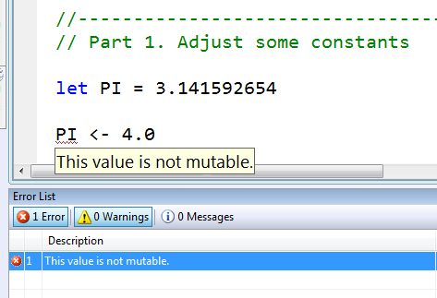
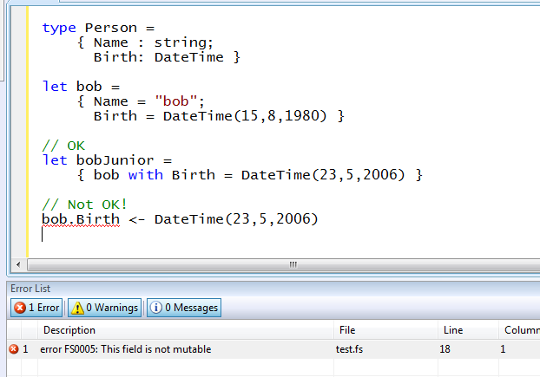
Immutability the norm…
Data is immutable by default
Values may not be changed
✓ Copy & Update
✗ Not Mutate

Slide 31
In Praise of Immutability
Immutable objects can be relied upon
Immutable objects can transfer between threads
Immutable objects can be aliased safely
Immutable objects lead to (different) optimization opportunities

Slide 32
F# - Functional
List.map Seq.fold
Array.filter Lazy.force Set.union
Map LazyList Events Async...
[ 0..1000 ]
[ for x in 0..10 -> (x, x * x) ]
[| for x in 0..10 -> (x, x * x) |]
seq { for x in 0..10 -> (x, x * x) }
Range
Expressions
List via query
Array via query
IEnumerable
via query

Slide 33
F# - Lists
Generated Lists
open System.IO
let rec allFiles(dir) =
[ for file in Directory.GetFiles(dir) do
yield file
for sub in Directory.GetDirectories(dir) do
yield! allFiles(sub) ]
allFiles(@"C:\Demo")

Slide 34
F# - Sequences
On-demand sequences
open System.IO
let rec allFiles(dir) =
seq
{ for file in Directory.GetFiles(dir) do
yield file
for sub in Directory.GetDirectories(dir) do
yield! allFiles(sub) }
allFiles(@"C:\WINDOWS")
|> Seq.take 100
|> show
Pipelines

Slide 35
Objects
Class Types
type ObjectType(args) =
let internalValue = expr
let internalFunction args = expr
let mutable internalState = expr
member x.Prop1 = expr
member x.Meth2 args = expr
Interface Types
type IObject =
interface ISimpleObject
abstract Prop1 : type
abstract Meth2 : type -> type
Constructing Objects
new FileInfo(@"c:\misc\test.fs")

Slide 36
F# - Objects + Functional
type Vector2D(dx:double,dy:double) =
member v.DX = dx
member v.DY = dy
member v.Length = sqrt(dx*dx+dy*dy)
member v.Scale(k) = Vector2D(dx*k,dy*k)
Inputs to object construction
Exported properties
Exported method

Slide 37
F# - Objects + Functional
type Vector2D(dx:double,dy:double) =
let norm2 = dx*dx+dy*dy
member v.DX = dx
member v.DY = dy
member v.Length = sqrt(norm2)
member v.Norm2 = norm2
Internal (pre-computed) values and functions

Slide 38
F# - Objects + Functional
Immutable inputs
type HuffmanEncoding(freq:seq<char*int>) =
...
< 50 lines of beautiful functional code>
...
member x.Encode(input: seq<char>) =
encode(input)
member x.Decode(input: seq<char>) =
decode(input)
Internal tables
Publish access

Slide 39
F# - Objects + Functional
type Vector2D(dx:double,dy:double) =
let mutable currDX = dx
let mutable currDX = dy
member v.DX = currDX
member v.DY = currDY
member v.Move(x,y) =
currDX <- currDX+x
currDY <- currDY+y
Internal state
Publish internal state
Mutate internal state

Slide 40
F# - Imperative
Using .NET collections
open System.Collections.Generic
let dict = new Dictionary<int,string>(1000)
dict.[17] <- "Seventeen"
dict.[1000] <- "One Grand"
for (KeyValue(k,v)) in dict do
printfn "key = %d, value = %s" k v

Slide 41
F# - Imperative
“use” =
C# “using”
open System.IO
open System.Collections.Generic
let readAllLines(file) =
use inp = File.OpenText file
let res = new List<_>()
while not(inp.EndOfStream) do
res.Add(inp.ReadLine())
res.ToArray()

Slide 42
Case Study The adPredict Competition

Slide 43
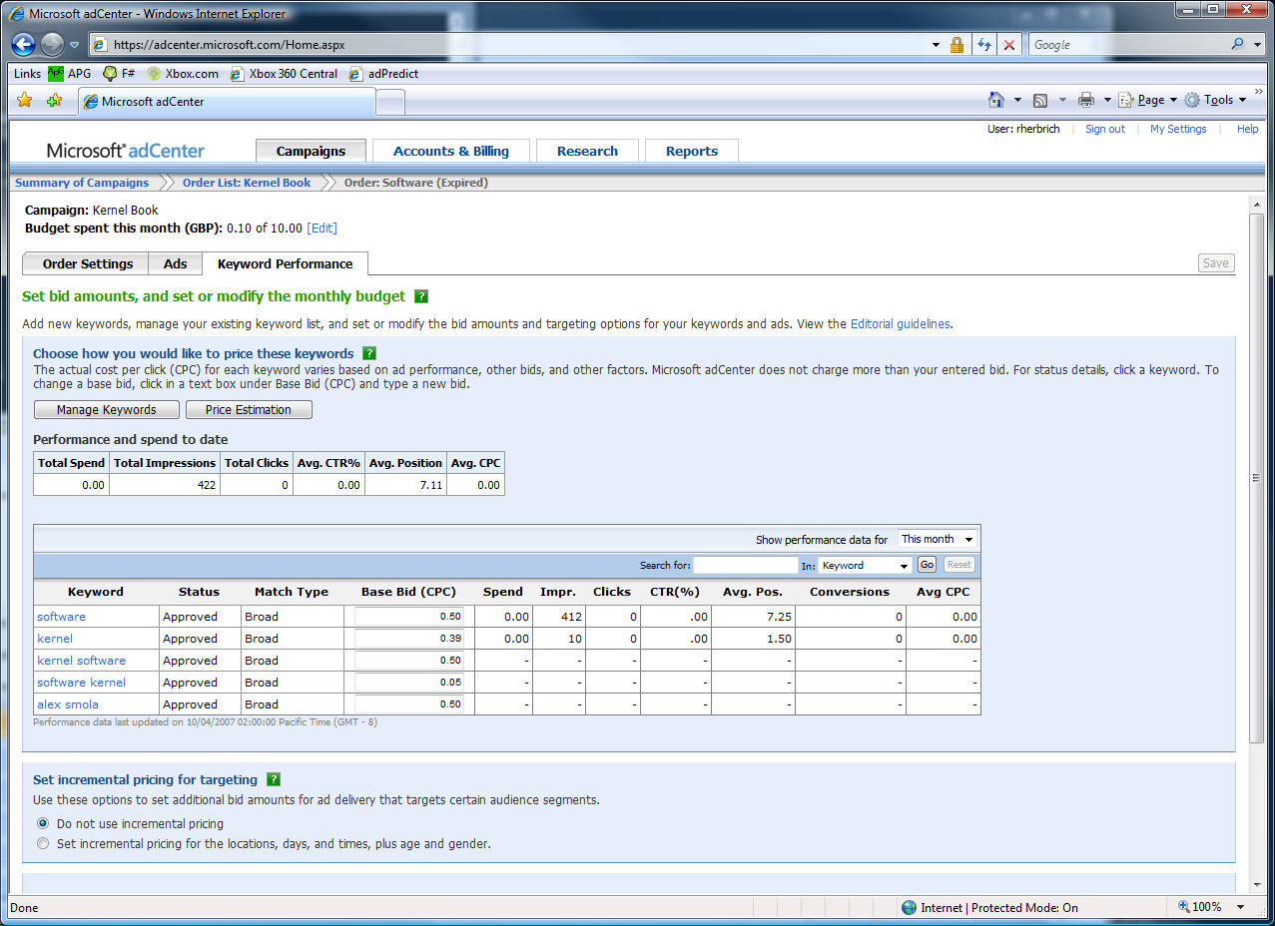

The adCenter Problem
Cash-cow of Search
Selling “web space” at www.live.com and www.msn.com.
“Paid Search” (prices by auctions)
The internal competition focuses on Paid Search.

Slide 44
The Scale of Things
Weeks of data in training:
7,000,000,000 impressions, 6TB data
2 weeks of CPU time during training:
2 wks × 7 days × 86,400 sec/day =
1,209,600 seconds
Learning algorithm speed requirement:
5,787 impression updates / sec
172.8 μs per impression update

Slide 45
F# and adCenter
4 week project, 4 machine learning experts
100million probabilistic variables
Processes 6TB of training data
Real time processing

Slide 46
AdPredict: What We Observed
F#’s powerful type inference means less typing, more thinking
Type-inferred code is easily refactored
Quick Coding
Agile Coding
Scripting
Performance
Memory-Faithful
Succinct
Symbolic
.NET Integration
“Hands-on” exploration.
Immediate scaling to massive data sets
mega-data structures, 16GB machines
Live in the domain, not the language
Schema compilation and “Schedules”
Especially Excel, SQL Server

Slide 47
F# Async/Parallel

Slide 48

Concurrent programming with shared state…
…can be hard

Slide 49
Assumptions
.NET Threads map to O/S threads

Slide 50
The Solution
In parallel programming,
F# is a power tool
for good architects and good developers
Good Architecture
Know your techniques
Know your requirements
Know your limits (CPU, disk, network, latency)
Aim: Translate Good Architecture into Good Code with F#
A great platform
A massive increase in isolation and immutability
A massive reduction in mutation
Powerful building blocks for good architecture

Slide 51
async { ... }
A Building Block for Async/Parallel/Reactive Design Patterns
async { ... }
For users:
You can run it, but it may take a while
Or, your builder says...
OK, I can do the job, but I might have to talk to someone else about it. I’ll get back to you when I’m done

Slide 52
Demo

Slide 53
Taming Asynchronous I/O
Open the file, synchronously
Equivalent F# code
(same perf)
Read from the file,
asynchronously
let ProcessImageAsync(i) =
async { use inStream = File.OpenRead(sprintf "source%d.jpg" i)
let! pixels = inStream.ReadAsync(numPixels)
let pixels' = TransformImage(pixels,i)
use outStream = File.OpenWrite(sprintf "result%d.jpg" i)
do! outStream.WriteAsync(pixels')
do Console.WriteLine "done!" }
let ProcessImagesAsync() =
Async.Run (Async.Parallel
[ for i in 1 .. numImages -> ProcessImageAsync(i) ])
This object coordinates
Write the result, asynchronously
“!”
= “asynchronous”
Generate the tasks and queue them in parallel

Slide 54
async { ... }
A Building Block for Async/Parallel/Reactive Design Patterns
async { ... }
More specifically:
User level tasks implemented using the continuation monad
try/catch, try/finally, start included
I/O primitives execute asynchronously (do not block O/S threads)
Explicit parallelism (StartChild, SwitchToNewThread)
Cooperative cancellation

Slide 55
async { ... }
Asynchronous "non-blocking" action
async { let! image = ReadAsync "cat.jpg"
let image2 = f image
do! writeAsync image2 "dog.jpg"
do printfn "done!"
return image2 }
Continuation/
Event callback
You're actually writing this (approximately):
async.Delay(fun () ->
async.Bind(ReadAsync "cat.jpg", (fun image ->
let image2 = f image
async.Bind(writeAsync "dog.jpg",(fun () ->
printfn "done!"
async.Return())))))

Slide 56
async { ... }
Asynchronous "non-blocking" action
async { let! image = ReadAsync "cat.jpg"
let image2 = f image
do! writeAsync image2 "dog.jpg"
do printfn "done!"
return image2 }
Continuation/
Event callback
You're actually writing this (approximately):
async.Delay(fun () ->
async.Bind(ReadAsync "cat.jpg", (fun image ->
let image2 = f image
async.Bind(writeAsync "dog.jpg",(fun () ->
printfn "done!"
async.Return())))))

Slide 57
async { ... }
Built on a much more general mechanism called “computation expressions”
seq { ... } (queries/sequences)
eventStream { ... } (queries over event streams)
parser { ... } (parser combinators)
resumable { ... } (resumptions)

Slide 58
Computation Expressions
Give the outer control structure of this syntactic expression different computational interpretation
expr = ident { expr }
cexpr; cexpr
let pat = expr in cexpr
use id = expr in cexpr
match expr with pat -> cexpr
if .. then cexpr else cexpr
try cexpr with pat -> cexpr
try cexpr finally cexpr
while ... do cexpr
for pat in ... do cexpr

Slide 59
Aims
Very Smooth Transitions to/from Monadic Code
For
Sequences
Database Queries
Asynchronous (non-blocking) Programming
“Put async { ... } around it and add let! where needed”

Slide 60
Wrap Up

Slide 61
8 Ways to Learn
FSI.exe
Samples Included
Go to definition
Lutz’ Reflector
http://cs.hubfs.net
Codeplex Fsharp Samples
Books
ML

Slide 62
Getting F#
September 2008: CTP released
F# will be a supported language in
Visual Studio 2010
Next stop: Visual Studio 2010 Beta 1
Look for it soon!

Slide 63
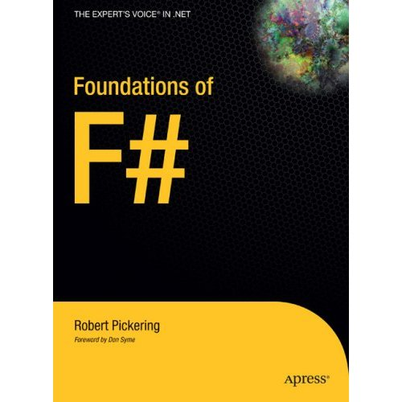
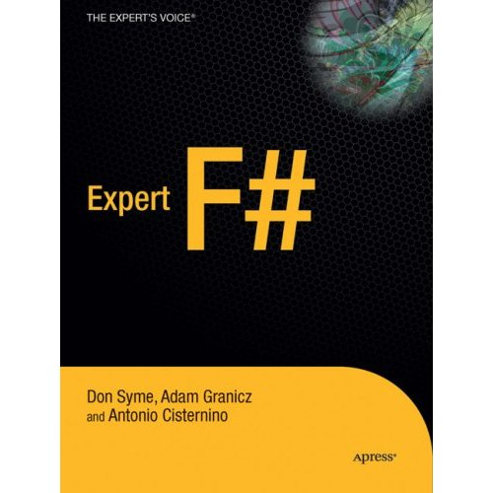
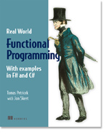

Books about F#
Visit www.fsharp.net

Slide 64
Questions & Discussion

Slide 65



© 2007 Microsoft Corporation. All rights reserved. This presentation is for informational purposes only. MICROSOFT MAKES NO WARRANTIES, EXPRESS OR IMPLIED, IN THIS SUMMARY.

Slide 66

1985
Mirror on underside of shuttle
SDI experiment: The plan
Big mountain in Hawaii

Slide 67
1985
SDI experiment:
The reality

Slide 68
1985
The reality

Slide 69

NASA Mars Climate Orbiter, 1999

Slide 70
NASA Mars Climate Orbiter, 1999

Slide 71
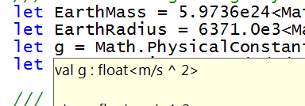
let EarthMass = 5.9736e24<kg>
// Average between pole and equator radii
let EarthRadius = 6371.0e3<m>
// Gravitational acceleration on surface of Earth
let g = PhysicalConstants.G * EarthMass / (EarthRadius * EarthRadius)

Slide 72
Computation Expressions
Add extra expression forms for monadic actions
expr = ident { expr }
| let! pat = expr
| return expr
cexpr; cexpr
let pat = expr in cexpr
use id = expr in cexpr
match expr with pat -> cexpr
if .. then cexpr else cexpr
try cexpr with pat -> cexpr
try cexpr finally cexpr
while ... do cexpr
for pat in ... do cexpr

Slide 73
type MonadBuilder() with
member Return : 'a -> M<'a>
member Delay : (unit -> M<'a>) -> M<'a>
member Bind: M<'a> * ('a -> M<'b>) -> M<'b>
let monad = MonadBuilder()

Slide 74
type AsyncBuilder() with
member Return : 'a -> Async<'a>
member Delay : (unit -> Async<'a>) -> Async<'a>
member Bind: Async<'a> * ('a -> Async<'b>) -> Async<'b>
let async = AsyncBuilder()

Slide 75
type MonadBuilder() with
member Return : 'a -> M<'a>
member Delay : (unit -> M<'a>) -> M<'a>
member Bind: M<'a> * ('a -> M<'b>) -> M<'b>
member Combine: M<unit> * M<'a> -> M<'a>
member TryFinally : M<'a> * (unit -> unit) -> M<'a>
member TryWith : M<'a> * (exn -> M<'a>) -> M<'a>
let monad = MonadBuilder()

Slide 76
Full Workflow Syntax & Translation
expr = ...
| expr { cexpr } -- let v = expr in v.Delay(fun () -> «cexpr»)
| { cexpr }
| [| cexpr |]
| [ cexpr ]
cexpr = let! pat = expr in cexpr -- v.Bind(expr,(fun pat -> «cexpr»))
| use pat = expr in cexpr -- v.Using(expr,(fun pat -> «cexpr»))
| do! cexpr1 in cexpr2 -- «let! () = cexpr1 in cexpr2»
| do expr in cexpr -- «let () = cexpr1 in cexpr2»
| for pat in expr do cexpr -- v.For(expr,(fun pat -> «cexpr»))
| while expr do cexpr -- v.While((fun () -> expr),
v.Delay(fun () -> «cexpr»))
| if expr then cexpr else cexpr -- if expr then «cexpr1» else «cexpr2»
| if expr then cexpr -- if expr then «cexpr1» else v.Zero()
| cexpr; cexpr -- v.Combine(«cexpr1», v.Delay(fun () -> «cexpr2»))
| return expr -- v.Return(expr)
| yield expr -- v.Yield(expr)
| match expr with [pat -> cexpr]+ -- ...
| try cexpr finally cexpr -- ...
| try cexpr with pat -> cexpr -- ...

